Slide 1

Circus Restaurant Website Designing
Team 4
Shujat Ali
Kaviya Ayyappan
Lohitha Yerramsetty
Sowjanya Penmetsa

Slide 2

Introduction of the project
We have designed a website for Circus Eats restaurant where the people can eat and watch the circus show.
Website contains an order system for the customers to place the order from the tablet in each table.
The restaurant will be organizing the special circus events on Fridays and Saturdays.
Customer can book for a circus event from our website.
By clicking on the advertisement on the home page customer can directly book for a circus show.
Website contains the contact and location information.

Slide 3

Requirements Gathering
1. Questionnaire Building
2. Tools for the survey
3. Problems with the survey form
4. Solution with google docs
Survey form.pdf

Slide 4
Requirements Analysis
We have received 19 responses based on the responses we have designed our website
https://docs.google.com/forms/d/1-BNMffPPqLnAsElK1lfHTR8Ib4FAEyqvoX3F1gGkIl4/viewanalytics
Example:
Language preference.
Quick Access & information with images.
Family oriented shows.
E:\Circus Restaurant -Team4\Documentation\Survey form And summary of the survey\Summary of the survey.pdf

Slide 5

Scrum Board
We created our scrum board using Trello.com
Daily Stand-up
Scrum Master
Task Assignment
https://trello.com/b/GgPWmiVx/circus-restaurant-project

Slide 6
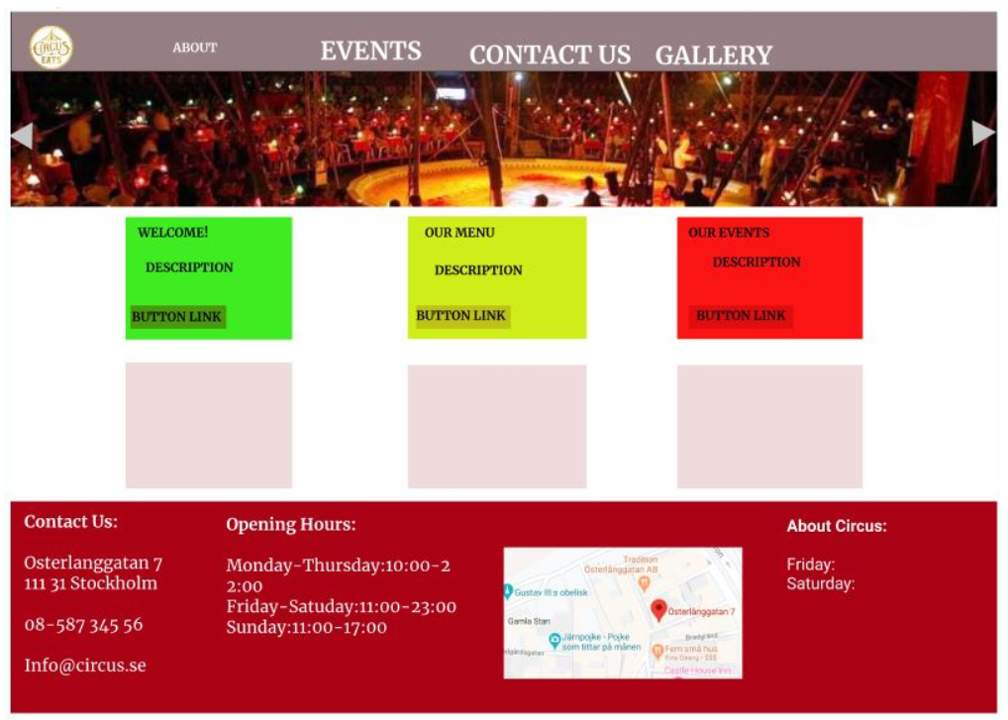
UI/UX Mockup Design
Designed the mockup by using Figma.com

Slide 7

UI/UX Mockup Design
Re-designed the mock-up using Balsamiq
Version 1
E:\Circus Restaurant -Team4\Documentation\Mock up Designs\mockup design using Balsamiq .pdf
Version 2
E:\Circus Restaurant -Team4\Documentation\Mock up Designs\mockup re-Design using balsamiq.pdf

Slide 8

Task Assigned
Shujat Ali
Home Module
Contact Module
About Module
Gallery Module
Sowjanya Penmetsa
Menu Module
Add to Cart Functionality
kaviya Ayyappan
Event Module
Language Translation Functionality
lohitha Yerramsetty
UI/UX wireframe
About, Gallery Modules
Documentation

Slide 9
Task Sharing Details
Resource Gathering:
Lohitha,Kaviya,Sowjanya
Ui/Ux design
Figma-Sowjanya,Lohitha,Kaviya,
Balsamiq Starting Model-Lohitha
Balsamiq Final Model-Kaviya
Menu page issue
Sowjanya, Shujat
Add to cart function
Sowjanya, kaviya
Event page responsive issue
Kaviya, Shujat
Fixing hyperlinks
Kaviya
Merging the final project code.
Kaviya, Shujat, Sowjanya
Power point presentation
Design-Sowjanya
Support: Kaviya,Shujath,Lohita
Project Documentation
Design: Lohita
Support: Sowjanya,Kaviya,Shuyat

Slide 10

Technologies used for the project
HTML(Hyper Text Markup Language)
CSS(Cascading Style Sheets)
Java Script
Jquery
Bootstrap

Slide 11
Demonstration of the project
E:\Circus Restaurant -Team4

Slide 12
E:\Circus Restaurant -Team4
Coding

Slide 13
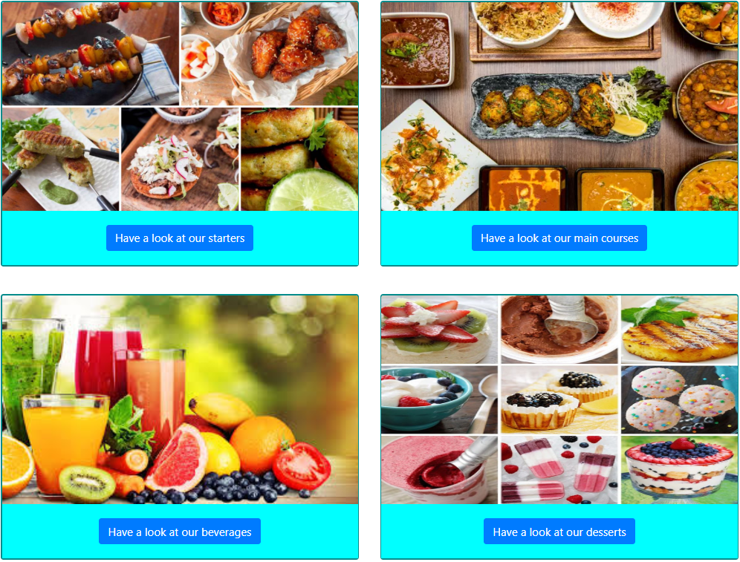
Menu Design Version 1
Menu.html

Slide 14
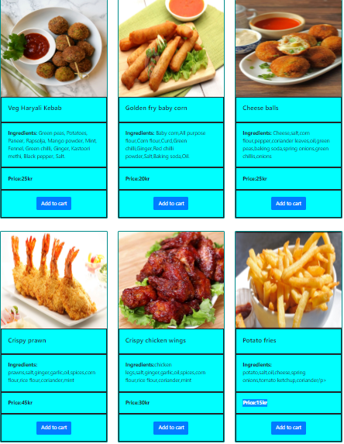
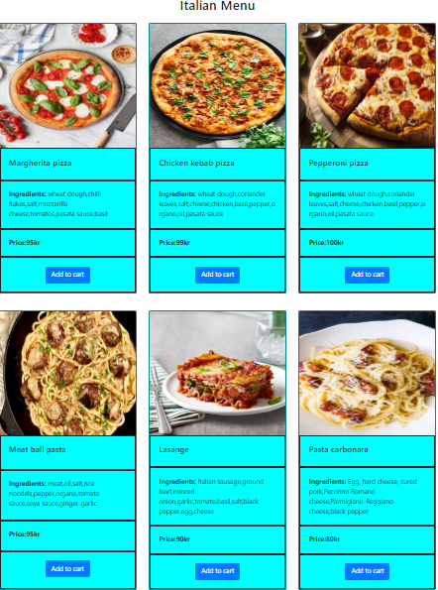
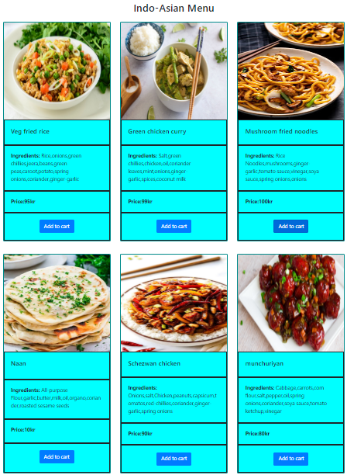
Starters.html
Main-Courses.html

Slide 15
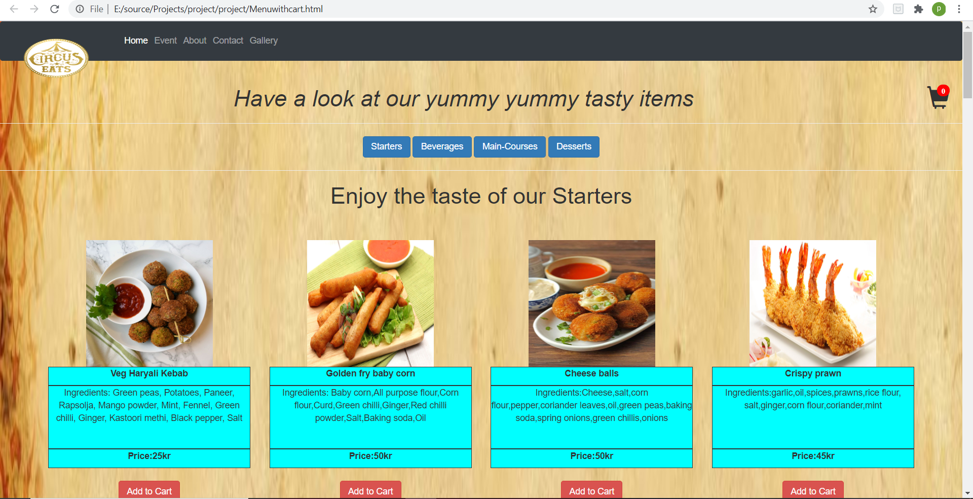
Menu Design Version 2

Slide 16
Thank You

